Slide 1
4P13
Week 9
Talking Points

Slide 2
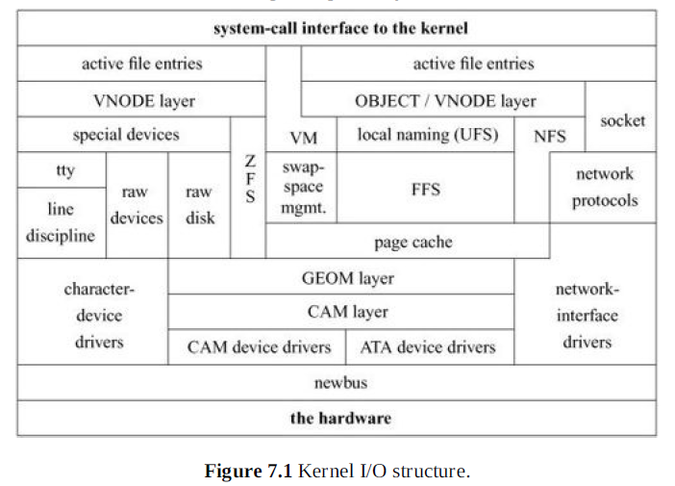

Slide 3
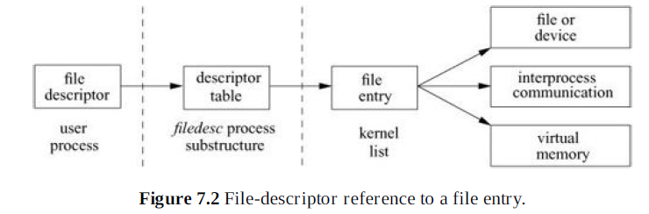

Slide 4
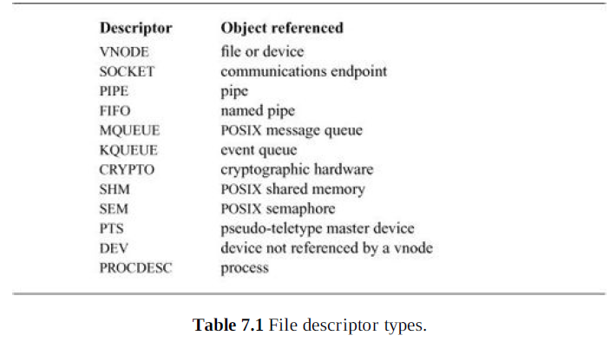

Slide 5
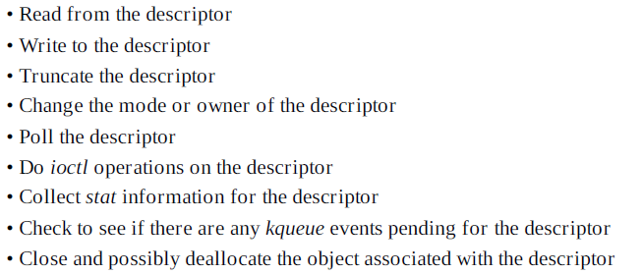

Slide 6
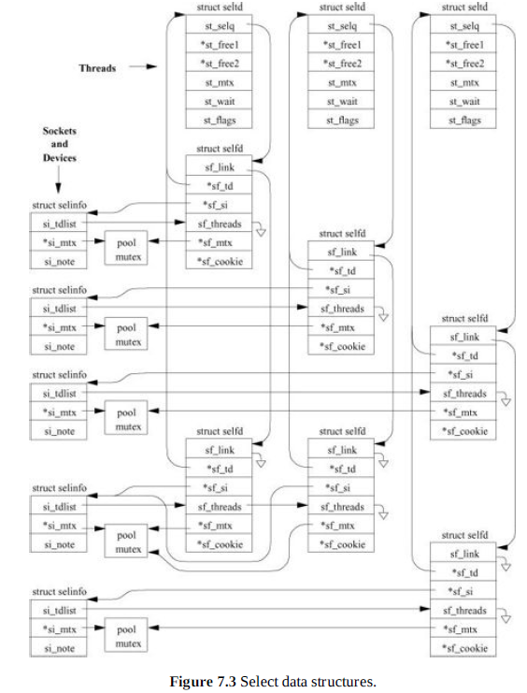

Slide 7
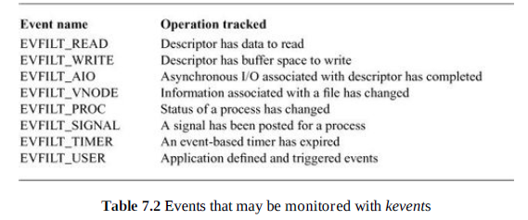

Slide 8
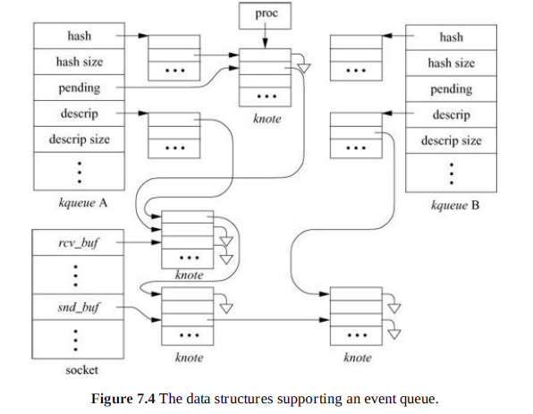

Slide 9
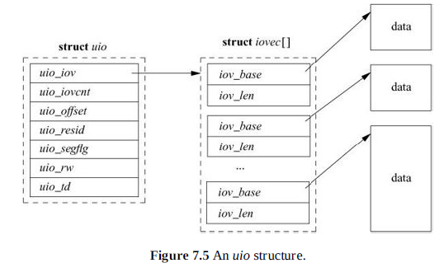

Slide 10
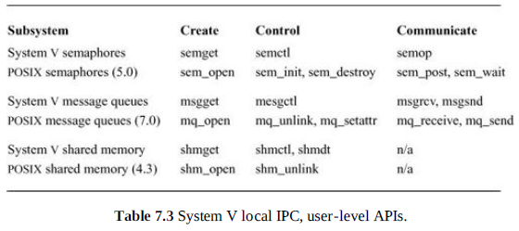

Slide 11
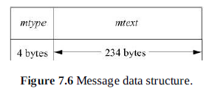

Slide 12
Contents of a Vnode
Flags are used for identifying generic attributes. An example of a generic attribute is a flag to show that a vnode represents an object that is the root of a filesystem.
The various reference counts include the number of file entries that are open for reading and/or writing that reference the vnode, the number of file entries that are open for writing that reference the vnode, and the number of pages and buffers that are associated with the vnode.
A pointer to the mount structure describes the filesystem that contains the object represented by the vnode.
Various information to perform file read-ahead.
A reference to the vm_object associated with the vnode.
A reference to state about special devices, sockets, and fifos.

Slide 13
Contents of a Vnode.
A mutex to protect the flags and counters within the vnode.
A lock-manager lock to protect parts of the vnode that may change while it has an I/O operation in progress.
Fields used by the name cache to track the names associated with the vnode.
A pointer to the set of vnode operations defined for the object. These operations are described in the next subsection.
A pointer to private information needed for the underlying object. For the local filesystem, this pointer will reference an inode; for NFS, it will reference an nfsnode.
The type of the underlying object (e.g., regular file, directory, character device, etc.) is given. The type information is not strictly necessary, since a vnode client could always call a vnode operation to get the type of the underlying object. However, because the type often is needed, the type of underlying objects does not change, and it takes time to call through the vnode interface,the object type is cached in the vnode.

Slide 14
Contents of a Vnode..
There are clean and dirty buffers associated with the vnode. Each valid buffer in the system is identified by its associated vnode and the starting offset of its data within the object that the vnode represents. All the buffers that have been modified but have not yet been written back are stored on their vnode dirty-buffer list. All buffers that have not been modified or have been written back since they were last modified are stored on their vnode clean list. Having all the dirty buffers for a vnode grouped onto a single list makes the cost of doing an fsync system call to flush all the dirty blocks associated with a file proportional to the amount of dirty data. In some UNIX systems, the cost is proportional to the smaller of the size of the file or the size of the buffer pool. The list of clean buffers is used to free buffers when a file is deleted. Since the file will never be read again, the kernel can immediately cancel any pending I/O on its dirty buffers, then reclaim all its clean and dirty buffers and place them at the head of the buffer free list, ready for immediate reuse.
A count is kept of the number of buffer write operations in progress. To speed the flushing of dirty data, the kernel does this operation by doing asynchronous writes on all the dirty buffers at once. For local filesystems, this simultaneous push causes all the buffers to be put into the disk queue so that they can be sorted into an optimal order to minimize seeking. For remote filesystems, this simultaneous push causes all the data to be presented to the network at once so that it can maximize their throughput. System calls that cannot return until the data are on stable store (such as fsync) can sleep on the count of pending output operations, waiting for the count to reach zero.

Slide 15
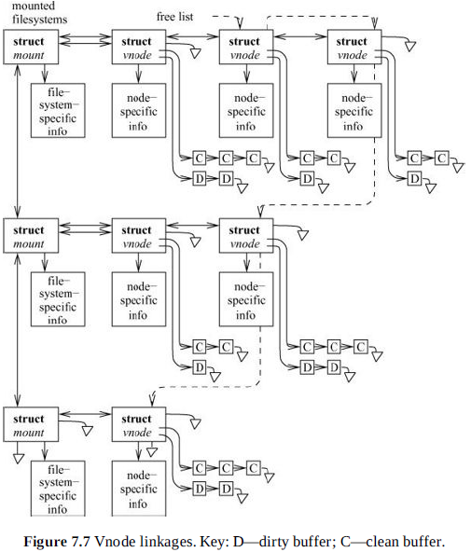

Slide 16
Pathname Translation Process
The pathname to be translated is copied in from the user process or, for a remote filesystem request, is extracted from the network buffer.
The starting point of the pathname is determined as either the root directory or the current directory (see Section 2.9). The vnode for the appropriate directory becomes the lookup directory used in the next step.
The vnode layer calls the filesystem-specific lookup() operation and passes to that operation the remaining components of the pathname and the current lookup directory. Typically, the underlying filesystem will search the lookup directory for the next component of the pathname and will return the resulting vnode (or an error if the name does not exist).
If an error is returned, the top level returns the error. If the pathname has been exhausted, the pathname lookup is done, and the returned vnode is the result of the lookup. If the pathname as not been exhausted, and the returned vnode is not a directory, then the vnode layer returns the “not a directory” error. If there are no errors, the top layer checks to see whether the returned directory is a mount point for another filesystem. If it is, then the lookup directory becomes the mounted filesystem; otherwise, the lookup directory becomes the vnode returned by the lower layer. The lookup then iterates with step 3.

Slide 17
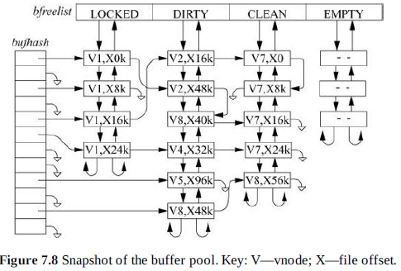

Slide 18
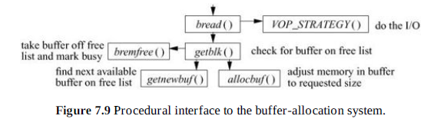

Slide 19
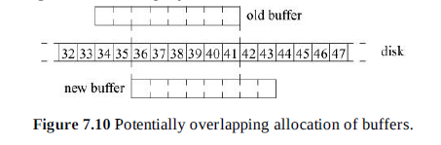

Slide 20
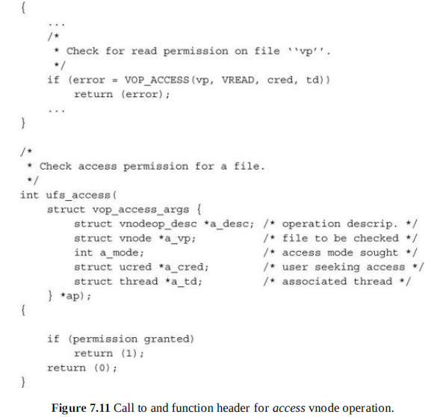

Slide 21
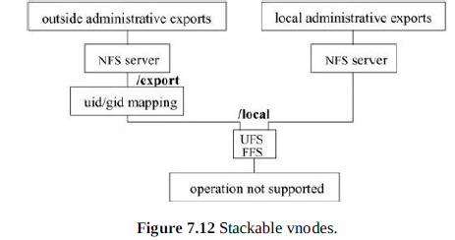

Slide 22
